Slide 1

DEPARTMENT OF CSE-CYBER SECURITY
Major Project
On
Enhanced Botnet Detection in IOT Systems Using a Hybrid Machine Learning Approach
SUBMITTED BY : BATCH - 11
M.Krushitha : 228R1A62H0
M.Harika : 228R1A62H1
M.Mercy : 228R1A62H3
P.Nikitha : 238R5A6221
UNDER THE GUIDANCE OF,
HEAD OF THE DEPARTMENT,
Dr. M. Ashwitha Reddy
Associate Professor & HOD
DEPARTMENT OF CSE-CS,
CMREC
Mr. Ch. Venkateswarlu
Assistant Professor,
DEPARTMENT OF CSE-CS
CMREC

Slide 2
ABSTRACT
With the rise of IoT, botnet attacks have become increasingly harmful and harder to detect due to evolving attack vectors. This research proposes a stacking model (ACLR) combining ANN, CNN, RNN, and ML models to identify botnet activity using the UNSW-NB15 dataset, which includes nine attack types. The ACLR model achieved 96.98% testing accuracy, ROC-AUC of 0.9934, and PR-AUC of 0.9950, showing strong detection performance. K-fold cross-validation (k = 3, 5, 7, 10) confirmed its robustness, with the best result at k = 5 (97.49%). The model outperformed existing methods, making it a valuable tool for improving cybersecurity against modern botnet threats. This system effectively captures complex attack patterns across diverse traffic data. Its high generalizability makes it suitable for real-world network environments. As cyber threats continue to evolve, the ACLR model offers a scalable and intelligent solution for proactive threat detection.

Slide 3
INTRODUCTION
The rapid growth of the Internet of Things (IoT) has enhanced connectivity across various sectors but also introduced severe security risks. Among these, botnet attacks have emerged as one of the most dangerous threats, exploiting vulnerable IoT devices to perform large-scale malicious activities. Traditional detection methods often struggle to identify such evolving attacks due to their dynamic and complex nature. To overcome these limitations, this project proposes a Hybrid Ensemble Learning Approach (ACLR) for efficient botnet attack detection in IoT systems. The ACLR model combines the strengths of ANN, CNN, RNN, and machine learning algorithms through a stacking mechanism to effectively capture spatial and temporal features of network traffic. Using the UNSW-NB15 dataset, which includes nine attack types, the model demonstrated superior accuracy and robustness compared to existing methods.
By achieving a testing accuracy of 96.98% and validating stability through k-fold cross-validation, the ACLR model proves to be a scalable and intelligent solution for proactive IoT threat detection. This approach contributes significantly to enhancing the overall cybersecurity posture of modern IoT environments.

Slide 4
SOFTWARE REQUIREMENTS
Operating system : Windows 7 Ultimate
Coding Language : Python
Front-End : Python
Back-End : Django-ORM
Designing : Html, css, javascript
Data Base : MySQL (WAMP Server)

Slide 5
HARDWARE REQUIREMENTS
Processor : Pentium –IV
RAM : 4 GB (min)
Hard Disk : 20 GB
Key Board : Standard Windows
Mouse : Two or Three Button
Monitor : SVGA

Slide 6
EXISTING SYSTEM
Botnets are a major cybersecurity threat used for DDoS attacks, data theft, and spam. Traditional detection methods fail to detect encrypted, unknown, and evolving threats. Deep learning models like CNN, LSTM, and hybrid CNN-LSTM have shown high accuracy (up to 99.57%) and cost efficiency in detecting botnet traffic, especially in IoT environments. ANN and BLSTM-RNN models also outperform traditional classifiers like SVM and Naive Bayes. These models enhance detection capabilities while reducing implementation costs by up to 75%.

Slide 7
Disadvantages (Limitations of Existing System):
Poor Detection of Unknown Botnets – Existing models struggle to identify new or unseen botnet types that differ from known attack patterns.
Inability to Handle Encrypted Traffic – Encrypted communication hides malicious content, making it difficult for models to analyze and detect threats accurately.
Lack of Adaptability – Most systems perform well only on specific datasets and fail to adapt to changing IoT environments or evolving attack methods.
High Implementation and Maintenance Cost – Advanced detection models require high computational resources and frequent updates, increasing cost and complexity.
Evasion by Attackers – Attackers use advanced evasion techniques to disguise malicious traffic, allowing botnets to bypass traditional detection systems.

Slide 8
PROPOSED SYSTEM
This research introduces a stacking model named ACLR, which integrates Artificial Neural Network (ANN), Convolutional Neural Network (CNN), Recurrent Neural Network (RNN), and traditional Machine Learning (ML) models to achieve efficient and accurate botnet attack detection in IoT environments. The model is designed to classify multiple types of attacks, including DoS, worms, backdoors, fuzzers, reconnaissance, shellcode, exploits, and generic attacks, using a well-preprocessed dataset. Performance evaluation is conducted using key metrics such as accuracy, precision, recall, F1-score, and ROC-AUC, ensuring comprehensive assessment of the model’s detection capability.
To validate the model’s stability and generalization, k-fold cross-validation is performed with k = 3, 5, 7, and 10, achieving consistent results across all folds. The proposed ACLR framework demonstrates superior detection accuracy and robustness compared to existing methods. By leveraging the combined strengths of deep learning and machine learning algorithms, this hybrid ensemble approach effectively captures complex patterns in IoT network traffic and offers a scalable, intelligent solution for modern cybersecurity challenges.

Slide 9
Advantages
Combines Multiple Learning Models – Integrates ANN, CNN, RNN, and ML models to enhance detection accuracy and learning capability.
Effective for a Wide Range of Attacks – Accurately identifies various attack types such as DoS, worms, backdoors, and reconnaissance.
Comprehensive Performance Evaluation – Assessed using multiple metrics like accuracy, precision, recall, F1-score, and ROC-AUC.
Robust Validation – Ensures reliability and stability through k-fold cross-validation with multiple values of k.
Outperforms Existing Models – Achieves higher accuracy and better generalization compared to traditional and standalone deep learning methods.

Slide 10
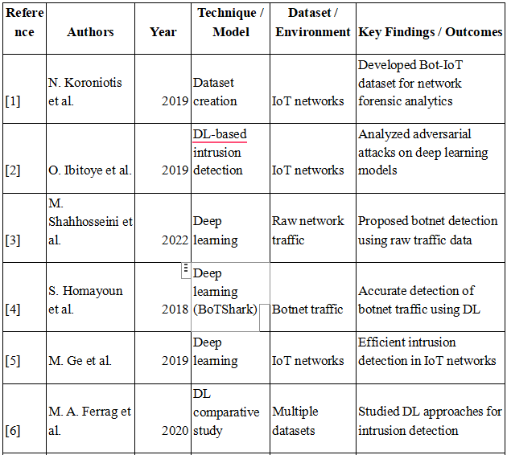
LITERATURE SURVEY

Slide 11
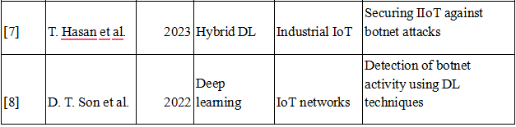
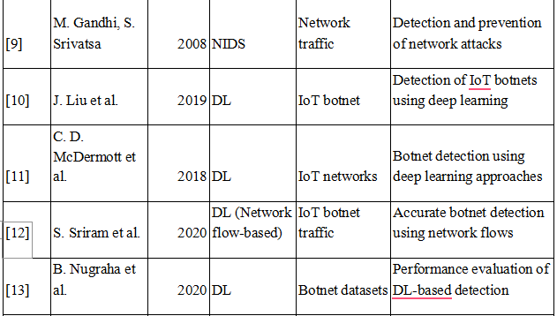
LITERATURE SURVEY

Slide 12
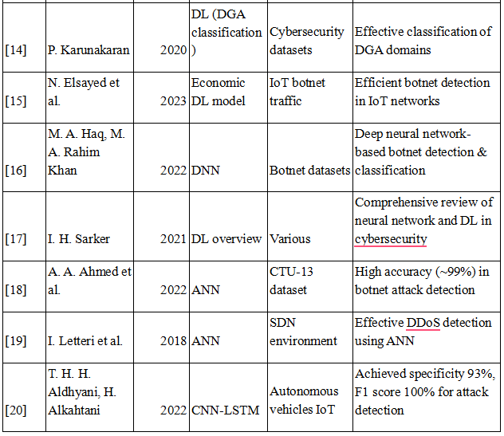
LITERATURE SURVEY

Slide 13
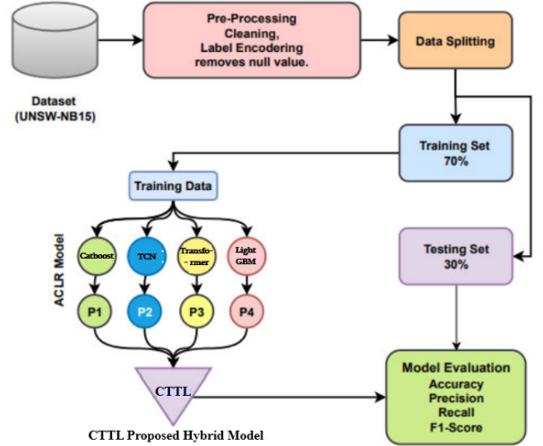
SYSTEM DESIGN
The proposed CTTL Hybrid ACLR model uses the UNSW-NB15 dataset, which is preprocessed and split into 70% training and 30% testing sets. Four base models — CatBoost, TCN, Transformer, and LightGBM — learn different traffic patterns, and their outputs are combined using a CTTL stacking layer. The final model’s performance is evaluated using accuracy, precision, recall, and F1-score metrics.

Slide 14
SYSTEM DESIGN
Data Flow Diagram A Data Flow Diagram (DFD) represents how data moves within a system, showing its flow between processes, data stores, and external entities. It illustrates how input data is processed, stored, and transformed into output. External entities act as data sources or destinations, while processes perform operations on data. Data flows indicate the direction of data movement. DFDs provide a clear, high-level view of system functionality through Level 0, Level 1, and Level 2 diagrams.

Slide 15
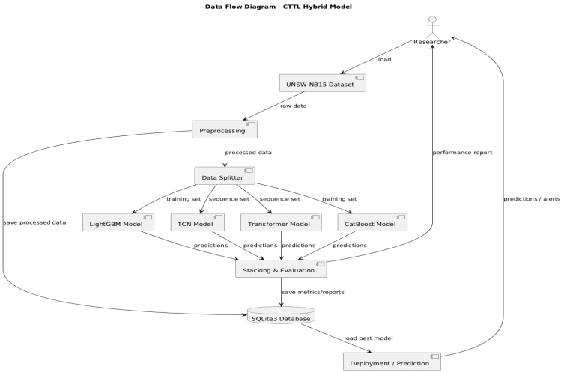
SYSTEM DESIGN

Slide 16
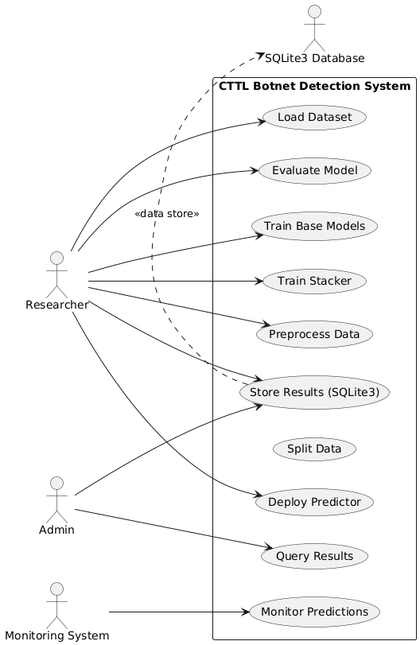
UML DIAGRAMS
Use case Diagram

Slide 17
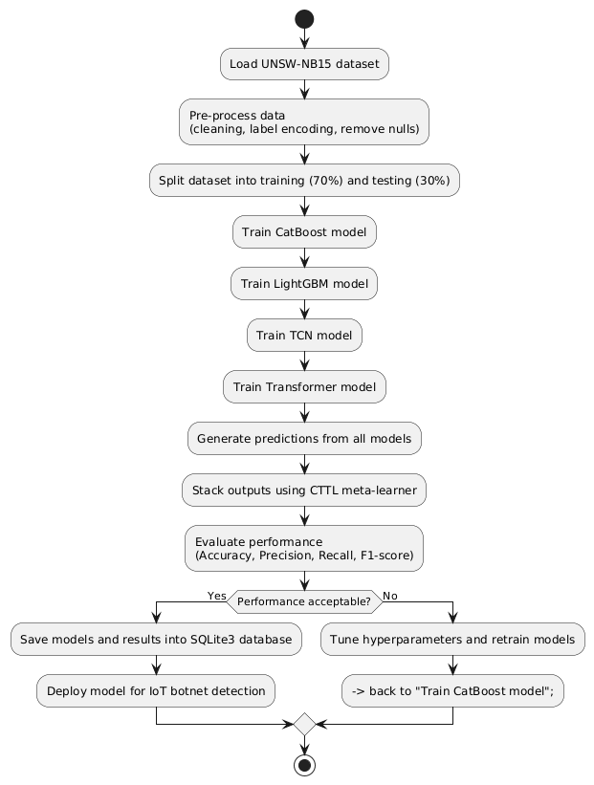
UML DIAGRAMS
Activity Diagram

Slide 18
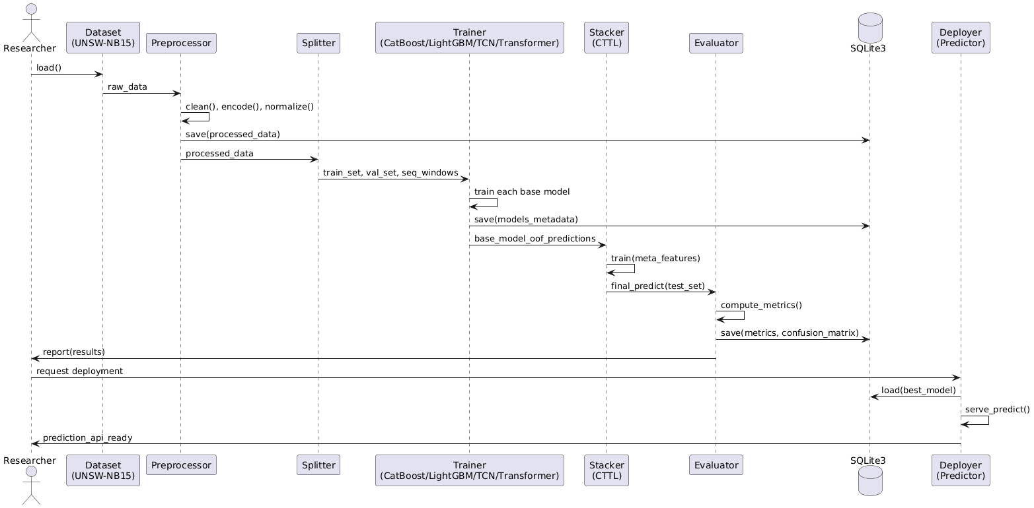
UML DIAGRAMS
Sequence Diagram

Slide 19
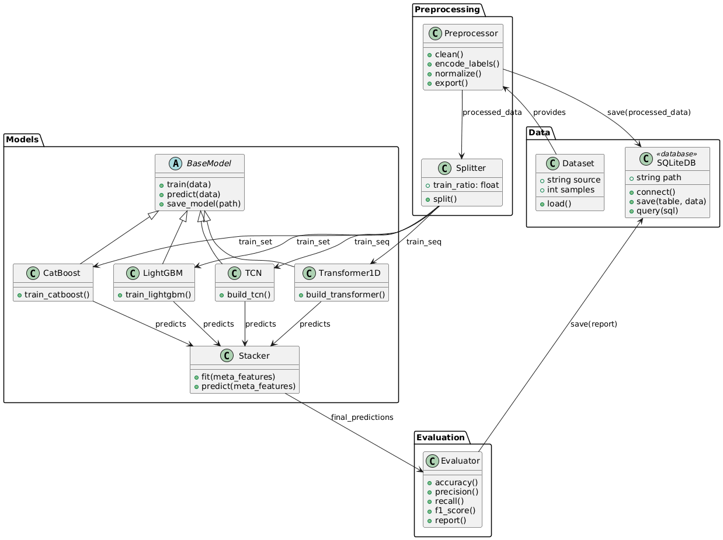
UML DIAGRAMS
Class Diagram

Slide 20
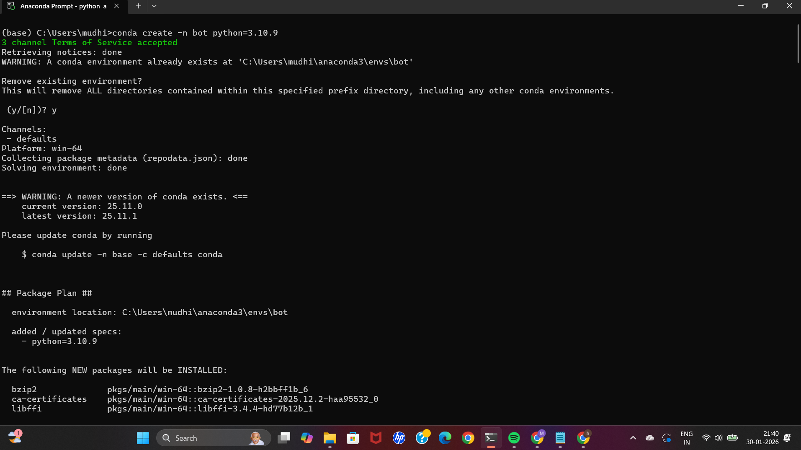
IMPLEMENTATION
Title: Python Environment and Dependency Setup
An isolated Anaconda virtual environment (bot) is created to avoid package conflicts.
Python version 3.10.9 is used for compatibility with machine learning libraries.
Required packages such as Flask, NumPy, Joblib, Scikit-learn, LightGBM, and PyTorch are installed using pip.
This setup ensures a stable runtime environment for hybrid ML model execution.

Slide 21
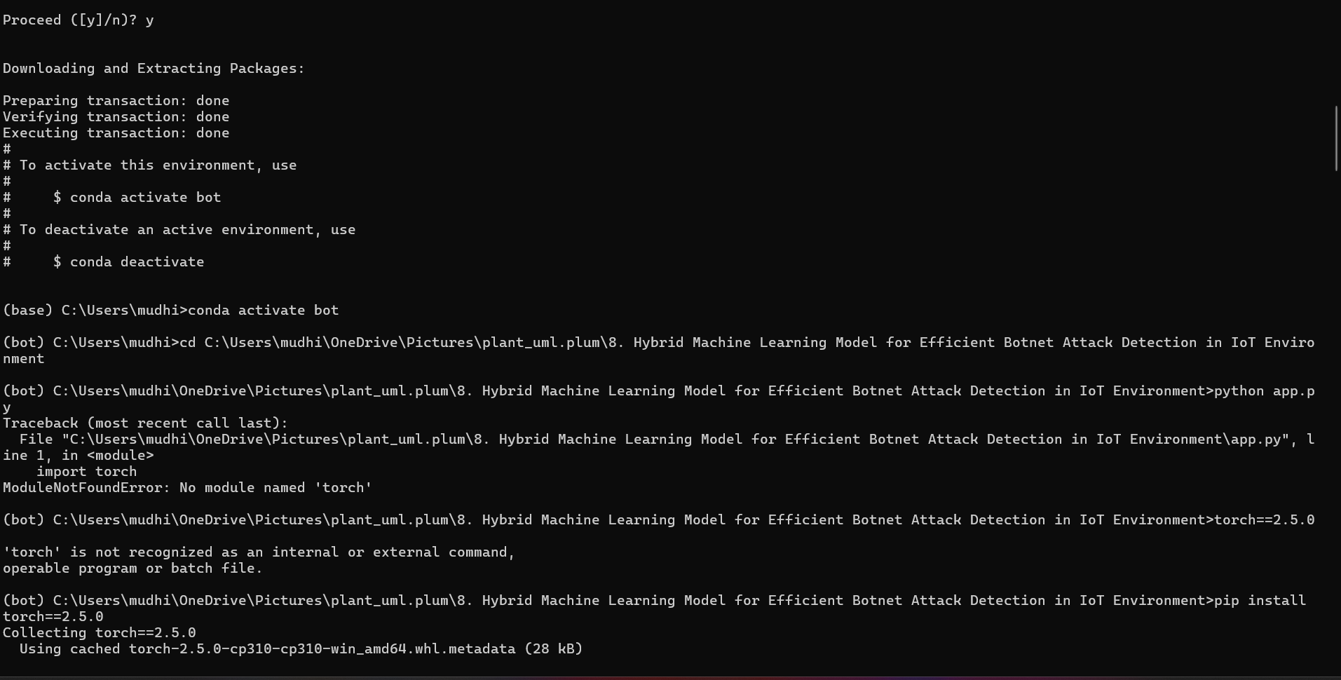
IMPLEMENTATION
Title: Web Framework Configuration
Flask (version 2.2.2) is installed to build the web interface of the system.
Supporting libraries such as Werkzeug, Jinja2, Click, and ItsDangerous are configured.
Flask acts as the backend server that connects user input with trained ML models.
The framework enables real-time prediction of botnet attacks through a browser interface.

Slide 22
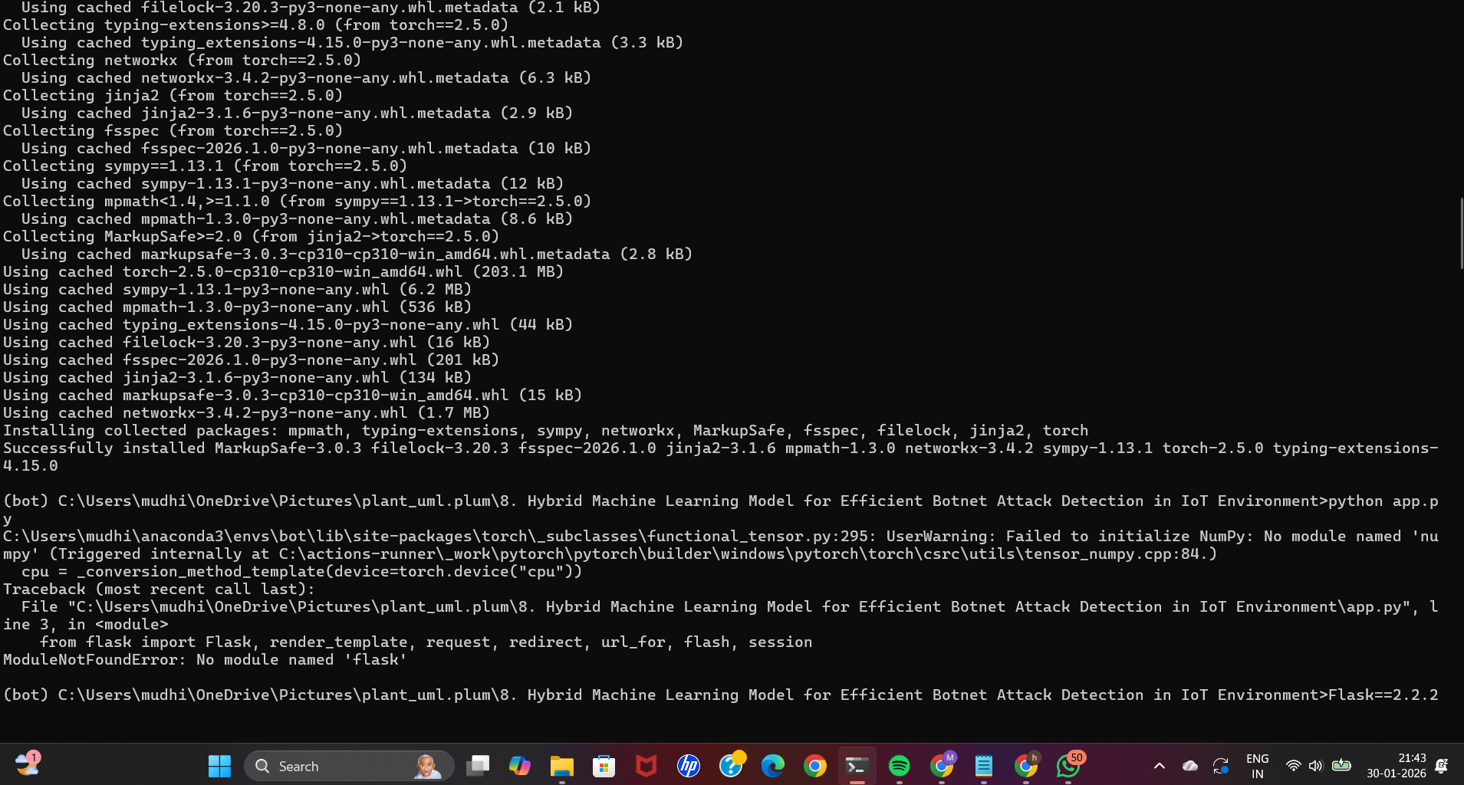
IMPLEMENTATION
Title: Dependency Conflict Resolution
Initial execution produced errors due to version mismatches between Flask and Werkzeug.
Werkzeug is downgraded to a compatible version (2.2.2) to resolve import errors.
This step ensures smooth communication between Flask components.
Proper dependency alignment is critical for stable application execution.

Slide 23
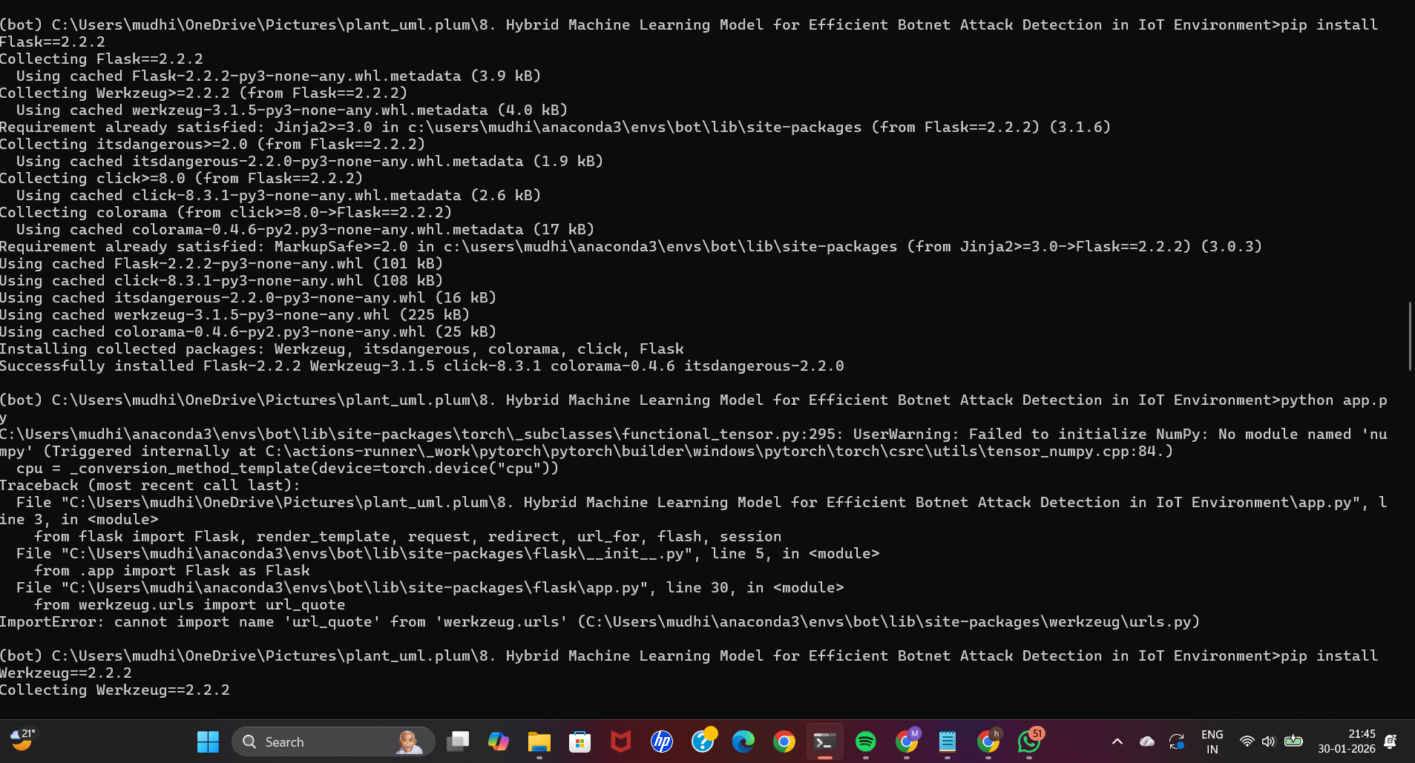
IMPLEMENTATION
Title: ML Model Support Libraries
Scikit-learn is installed to support classical machine learning models.
Joblib is used to load trained models and feature scalers (.sav, .pkl files).
LightGBM is installed to support gradient boosting-based botnet detection.
These libraries form the traditional ML part of the hybrid approach.

Slide 24
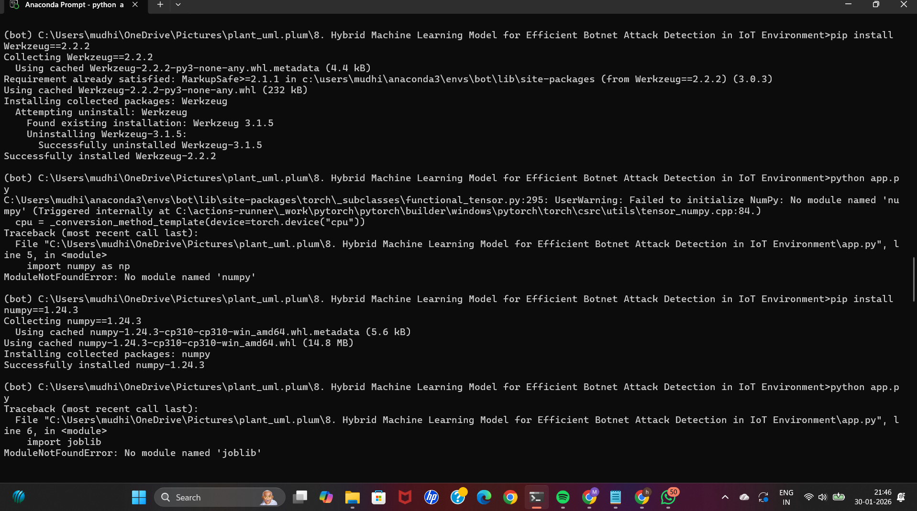
IMPLEMENTATION
Title: PyTorch Model Integration
PyTorch (torch 2.5.0) is installed for deep learning model execution.
The trained Attention-based CNN-BiLSTM model is loaded using torch.load().
CPU-based inference is used for model prediction.
This deep learning model captures complex temporal and spatial patterns in IoT traffic.

Slide 25
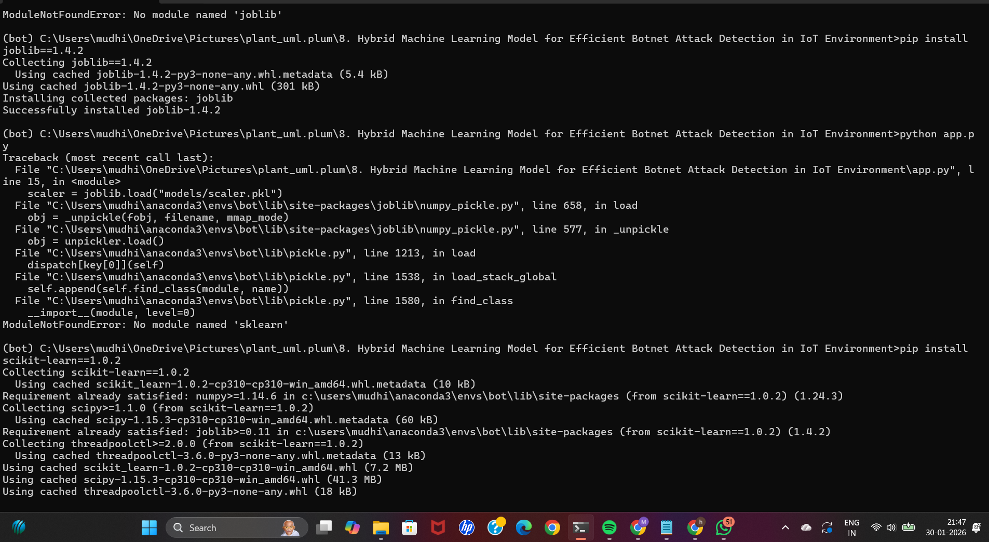
IMPLEMENTATION
Title: Hybrid Model Loading Process
Multiple trained models are loaded:
Classical ML model (model.sav)
Feature scaler (scaler.pkl)
Deep learning model (att_cnn_bilstm.pth)
Models are loaded at application startup to reduce prediction latency.
This enables ensemble-based decision making for botnet detection.

Slide 26
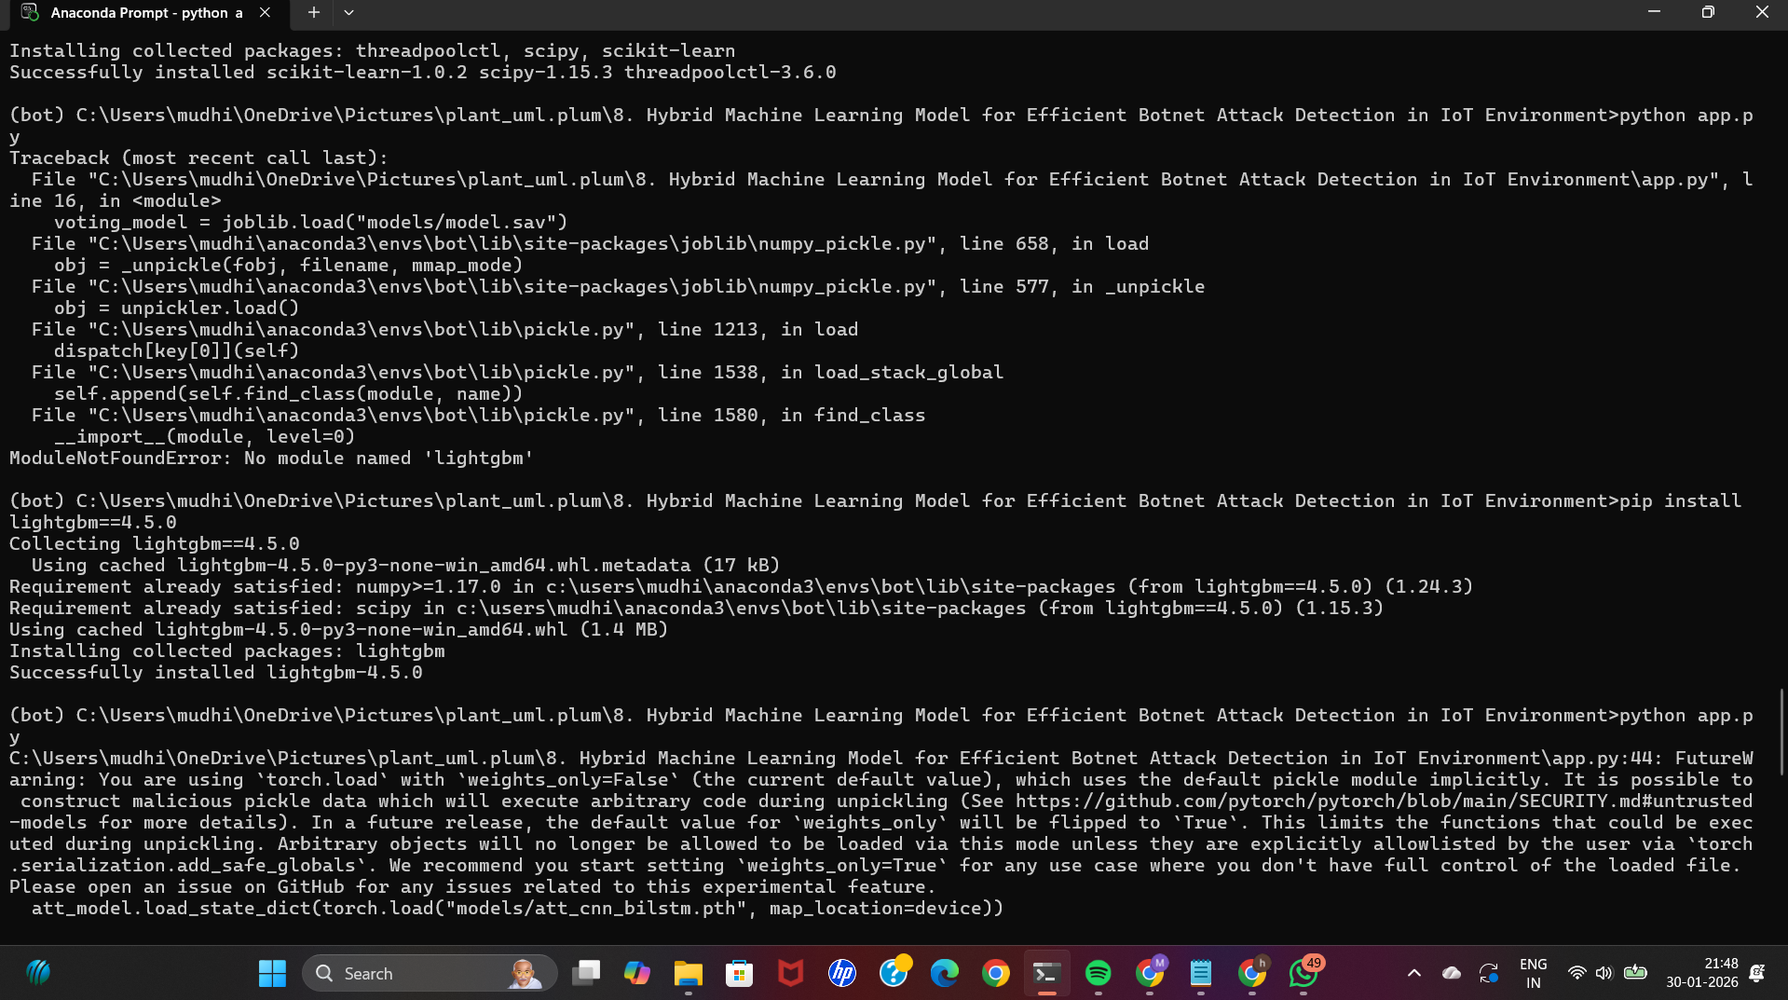
IMPLEMENTATION
Title: Flask Application Execution
The Flask application is executed using python app.py.
The server starts successfully without runtime errors.
Flask runs in development mode on a local machine.
The system is now ready to accept input data for prediction.

Slide 27
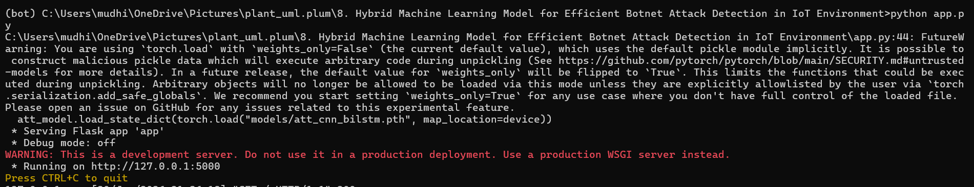
IMPLEMENTATION
Title: System Running Successfully
Flask server runs on http://127.0.0.1:5000.
The web interface becomes accessible through a browser.
Users can input IoT traffic data and receive botnet detection results.
This confirms successful integration of hybrid ML models with the web application.

Slide 28
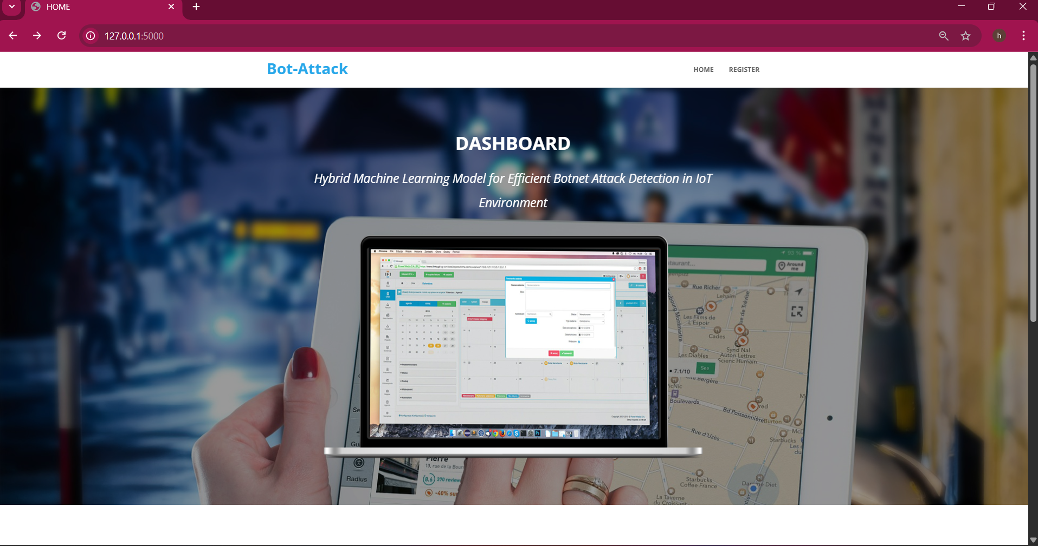
IMPLEMENTATION
Title: Project Home Page – Bot-Attack Dashboard
Description:
This slide shows the home page of the Bot-Attack web application.
The dashboard introduces the project titled “Hybrid Machine Learning Model for Efficient Botnet Attack Detection in IoT Environment.”
It provides a user-friendly interface for accessing the system.
Navigation options such as Home and Register are available for users.
The dashboard acts as the entry point to the botnet detection system.
Purpose:
To present an overview of the system and allow users to start interaction with the application.

Slide 29
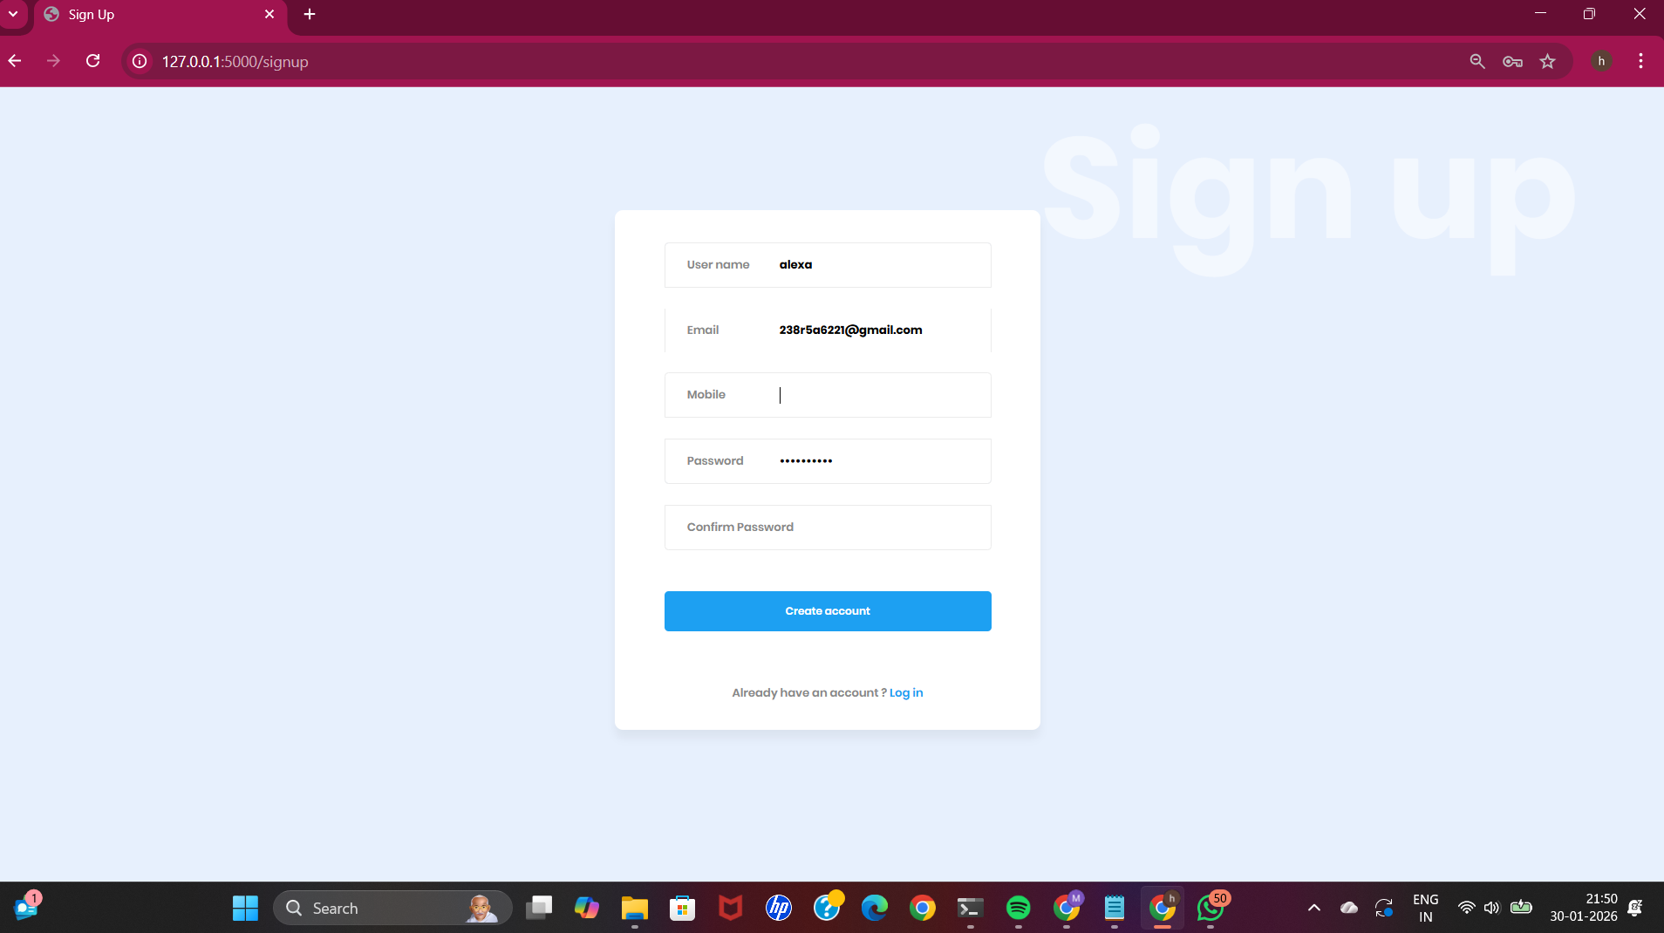
IMPLEMENTATION
Title: User Registration Module
Description:
This slide displays the Sign-Up page of the application.
Users can create an account by entering:
Username
Email ID
Mobile Number
Password and Confirm Password
The system validates user input before account creation.
An option is provided for existing users to log in directly.
Purpose:
To ensure secure and authenticated access to the botnet detection system.

Slide 30
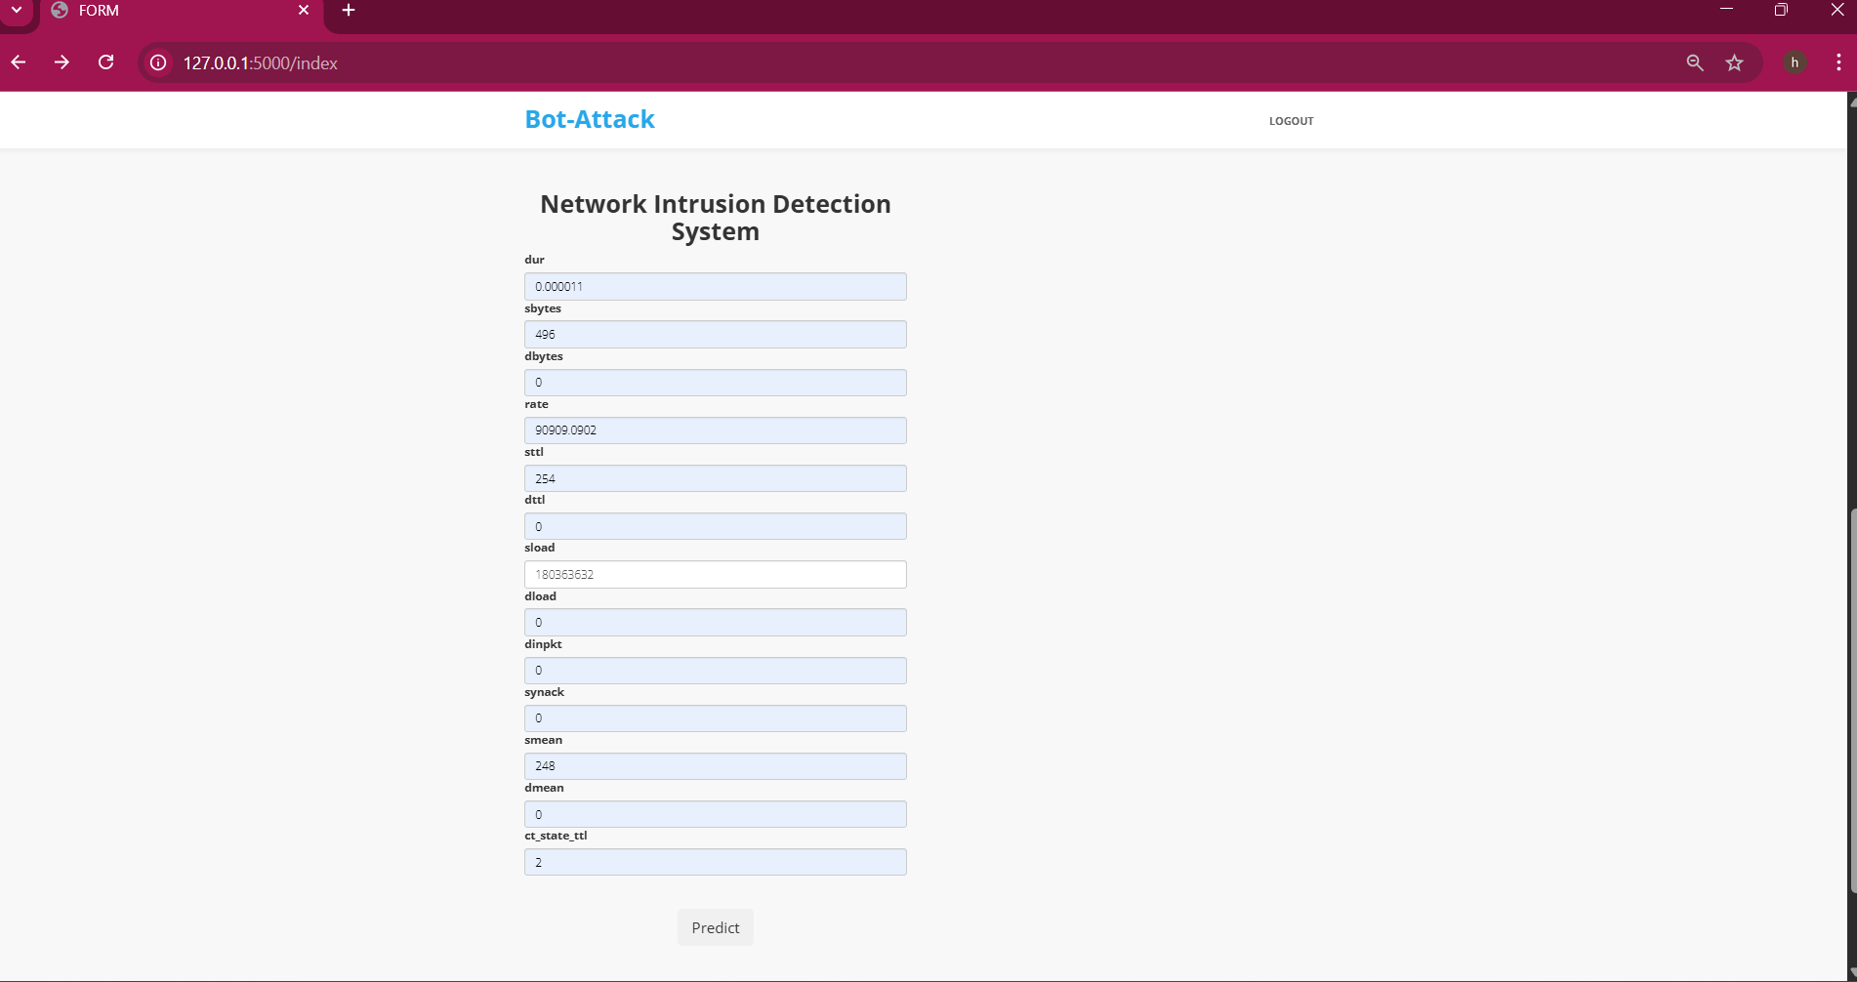
IMPLEMENTATION
Title: Network Intrusion Detection System – Input Module
Description:
This slide shows the network traffic feature input form.
Users manually enter IoT network parameters such as:
Duration (dur)
Source bytes (sbytes)
Destination bytes (dbytes)
Rate, TTL values
Load and packet-related features
These features represent real-time IoT network traffic behavior.
Purpose:
To collect network traffic data for botnet attack prediction using machine learning models.

Slide 31
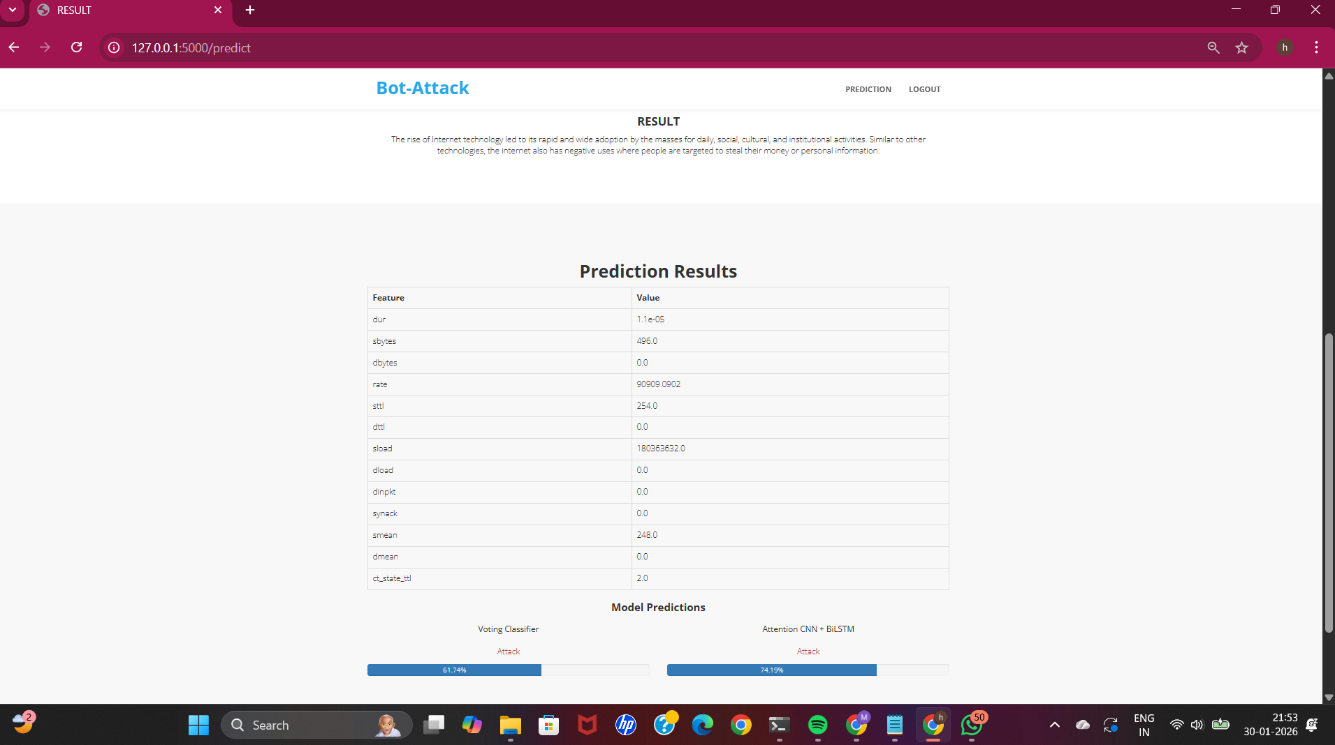
IMPLEMENTATION
Title: Botnet Attack Detection – Prediction Results
Description:
This slide displays the prediction results after submitting network parameters.
The system uses a Hybrid Machine Learning Approach for detection.
Two models are applied:
Voting Classifier
Attention-based CNN + BiLSTM
Both models classify the traffic as Attack with confidence percentages.
Purpose:
To clearly identify whether the given IoT traffic is Normal or Malicious (Botnet Attack).
To improve detection accuracy using multiple ML models.

Slide 32
Conclusion
The proposed Hybrid Ensemble Learning Approach (ACLR) provides an efficient and intelligent solution for botnet attack detection in IoT networks. By integrating CatBoost, TCN, Transformer, and LightGBM models through a CTTL stacking framework, the system effectively captures complex spatial and temporal features of network traffic. Using the UNSW-NB15 dataset, the model achieved high accuracy, precision, and robustness, outperforming existing methods. The results demonstrate that the ACLR model is not only accurate but also scalable and adaptable for real-world IoT environments. This approach contributes significantly to enhancing cybersecurity by enabling early, reliable, and automated detection of evolving botnet threats.

Slide 33
References
[1] N. Koroniotis, N. Moustafa, E. Sitnikova, and B. Turnbull, ‘‘Towards the development of realistic botnet dataset in the Internet of Things for network forensic analytics: Bot-IoT dataset,’’ Future Gener. Comput. Syst., vol. 100, pp. 779–796, Nov. 2019.
[2] O. Ibitoye, O. Shafiq, and A. Matrawy, ‘‘Analyzing adversarial attacks against deep learning for intrusion detection in IoT networks,’’ in Proc. IEEE Global Commun. Conf. (GLOBECOM), Dec. 2019, pp. 1–6.
[3] M. Shahhosseini, H. Mashayekhi, and M. Rezvani, ‘‘A deep learning approach for botnet detection using raw network traffic data,’’ J. Netw. Syst. Manage., vol. 30, no. 3, p. 44, Jul. 2022.
[4] S. Homayoun, M. Ahmadzadeh, S. Hashemi, A. Dehghantanha, and R. Khayami, ‘‘BoTShark: A deep learning approach for botnet traffic detection,’’ in Cyber Threat Intelligence, 2018, pp. 137–153.
[5] M. Ge, X. Fu, N. Syed, Z. Baig, G. Teo, and A. Robles-Kelly, ‘‘Deep learning-based intrusion detection for IoT networks,’’ in Proc. IEEE 24th Pacific Rim Int. Symp. Dependable Comput. (PRDC), Dec. 2019, p. 256.

